Slide 1


MADHAV INSTITUTE OF TECHNOLOGY & SCIENCE, GWALIOR (A Govt. Aided UGC Autonomous
& NAAC Accredited Institute Affiliated to RGPV, Bhopal)
DEPARTMENT OF INFORMATION TECHNOLOGY
DESIGN AND THINKING LAB (280406)
Skill Based project
SUBMITTED BY-
Pratima Jadon(0901M211039)
Rudraksh Saraf(0901AM211046)
Sakshi Tandon(0901AM211048)
Siddhant Jain(0901AM211058)
Pragya Bhadoria(0901AM220D03)
SUBMITTED TO-
Dr. Kritika Bansal
Dr. Dhananjay Bisen

Slide 2
CONTENTS
Introduction
Micro Project
Macro Project
Mini Project
Applications
Conclusion

Slide 3
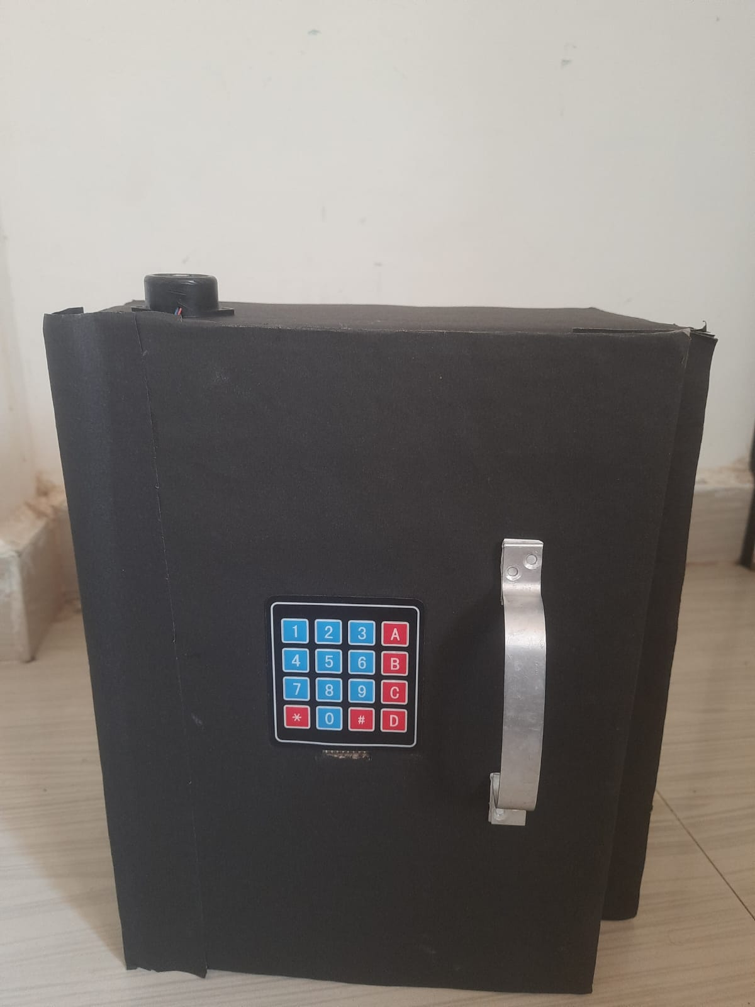
1
Digital Safe
INTRODUCTION
A digital safe is a secure storage container that uses an Arduino microcontroller board to control access to the safe. The safe is equipped with a keypad or a fingerprint scanner to allow authorized users to open the safe, while preventing unauthorized access.
The project aims to design a digital safe using Arduino, which is an open-source platform for building electronics projects.
The code for the safe will be written in the Arduino programming language, and the safe will be powered by a 9V battery.
The project will demonstrate the use of microcontrollers in building practical applications and will be a useful tool for securing personal belongings

Slide 4
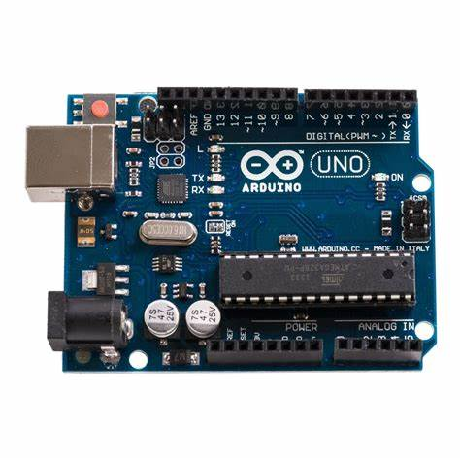
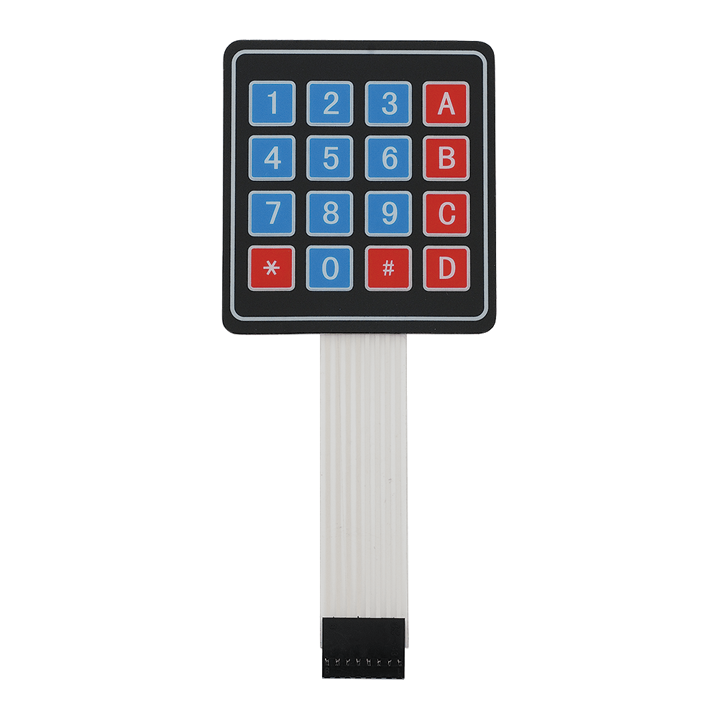
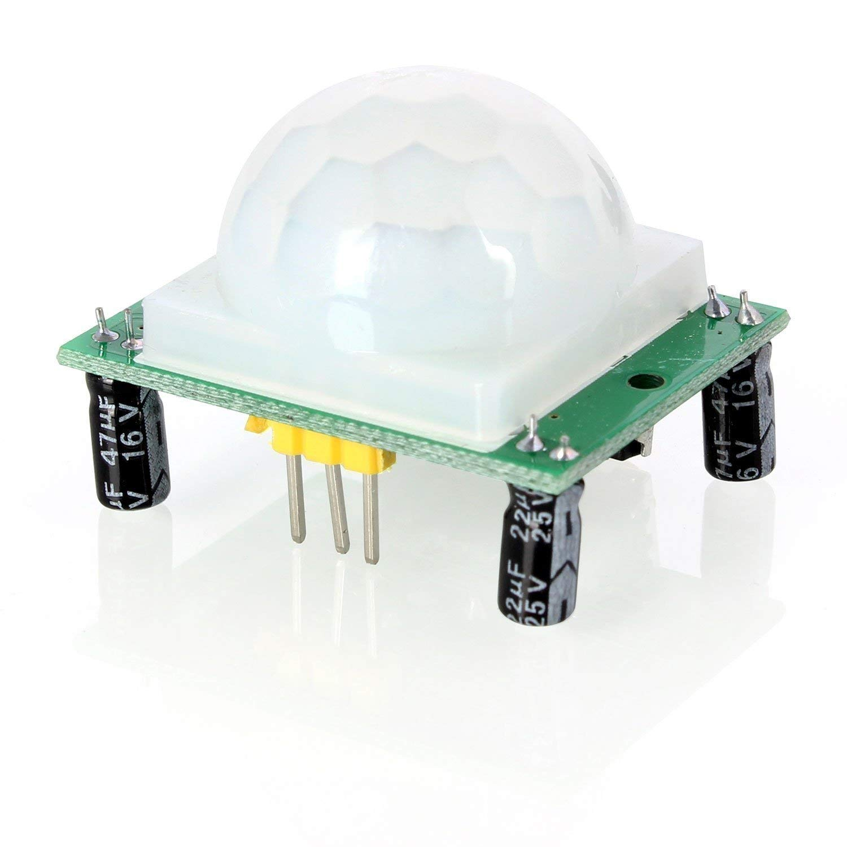

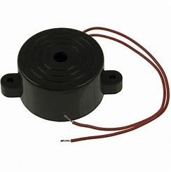
MICRO PROJECT
COMPONENTS USED IN OUR PROJECT-
Fig.1
ARDUINO UNO R3 MICROCONTROLLER
Fig.2
PIR SENSOR
Fig.3
KEYPAD(4 x 4)
Fig.4
SERVO MOTOR
Fig.5
BUZZER

Slide 5
MACRO PROJECT
IMPLEMENTATION OF ‘KEYPAD AND LCD’
Fig.6

Slide 6


CODE-

Slide 7
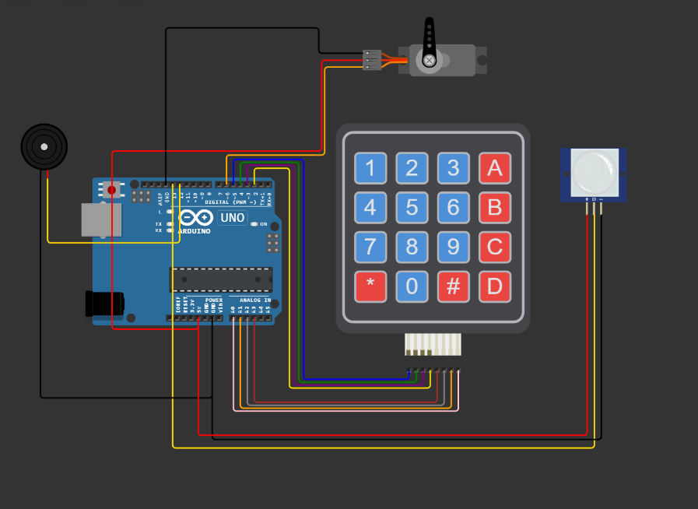
MINI PROJECT
The Main objective of mini project is the connection of LCD, buzzer, keypad, PIR sensor, servo motor, and Arduino for a digital safe
Forum
About us
Our Values
Fig.7

Slide 8
Video Representation

Slide 9


Slide 10
APPLICATIONS
Home Security
Business Security
Hotel Rooms
Gun Safes ,Personal Lockers etc.

Slide 11
BIBLIOGRAPHY
Arduino. (2021). Arduino Uno. Retrieved from https://www.arduino.cc/en/Guide/ArduinoUno
Patel, S. (2020). How to Make a Digital Safe with Arduino. Arduino Project Hub. Retrieved from https://create.arduino.cc/projecthub/shubham-patel/how-to-make-a-digital-safe-with-arduino-2b10d6
Fergus, J. (2019). Digital Safe. In Arduino Project Handbook: 25 Practical Projects to Get You Started (pp. 86-92). San Francisco, CA: No Starch Press.
Huang, J., Zhang, H., & He, L. (2020). A Digital Safe System Based on Arduino. Journal of Physics: Conference Series, 1659(1), 012053. doi: 10.1088/1742-6596/1659/1/012053
Banzi, M. (2011). Getting Started with Arduino (2nd ed.). Sebastopol, CA: O'Reilly Media, Inc.
Singh, A. (2019). Development of a Digital Safe Using Arduino Microcontroller. International Journal of Innovative Technology and Exploring Engineering, 8(11), 678-682. doi: 10.35940/ijitee.L1137.1181119
TutorialsPoint. (2021). Arduino - Password Protected Digital Safe. Retrieved from https://www.tutorialspoint.com/arduino/arduino_password_protected_digital_safe.htm
Arduino Forum. (2021). Digital Safe with Servo and Keypad. Retrieved from https://forum.arduino.cc/t/digital-safe-with-servo-and-keypad/546604

Slide 12
CONCLUSION
In conclusion, the digital safe project using Arduino Uno is an effective and reliable solution for securing valuable items.
With the use of an electronic lock mechanism, the safe can only be opened with the correct password input.
The Arduino Uno microcontroller serves as the brains of the operation, providing the necessary logic to control the lock and user interface.
The project involves several important components, including the keypad, LCD screen, and servo motor.
By combining these components with the Arduino Uno board, it's possible to create a robust and user-friendly safe system.

Slide 13
THANK YOU !

